Slide 1
Spatial distribution IUCN
Spatial distribution Aquamaps
Presence-Absence Matrix (0.5°x0.5°)
Distance-Trait Matrix
Functional metrics at 0.5°x0.5°

Slide 2
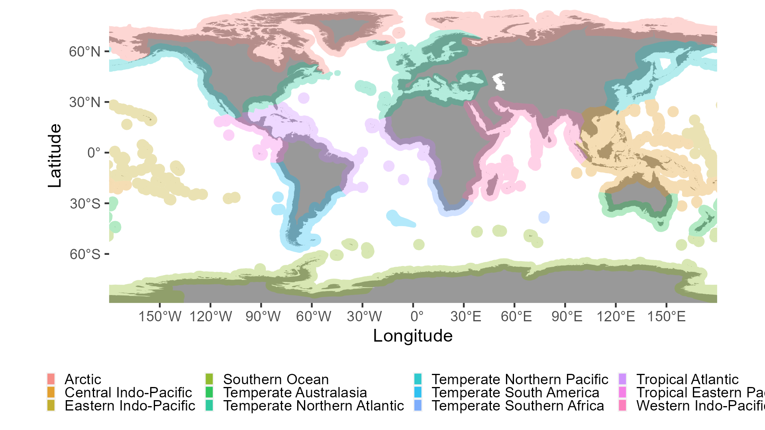

Slide 3
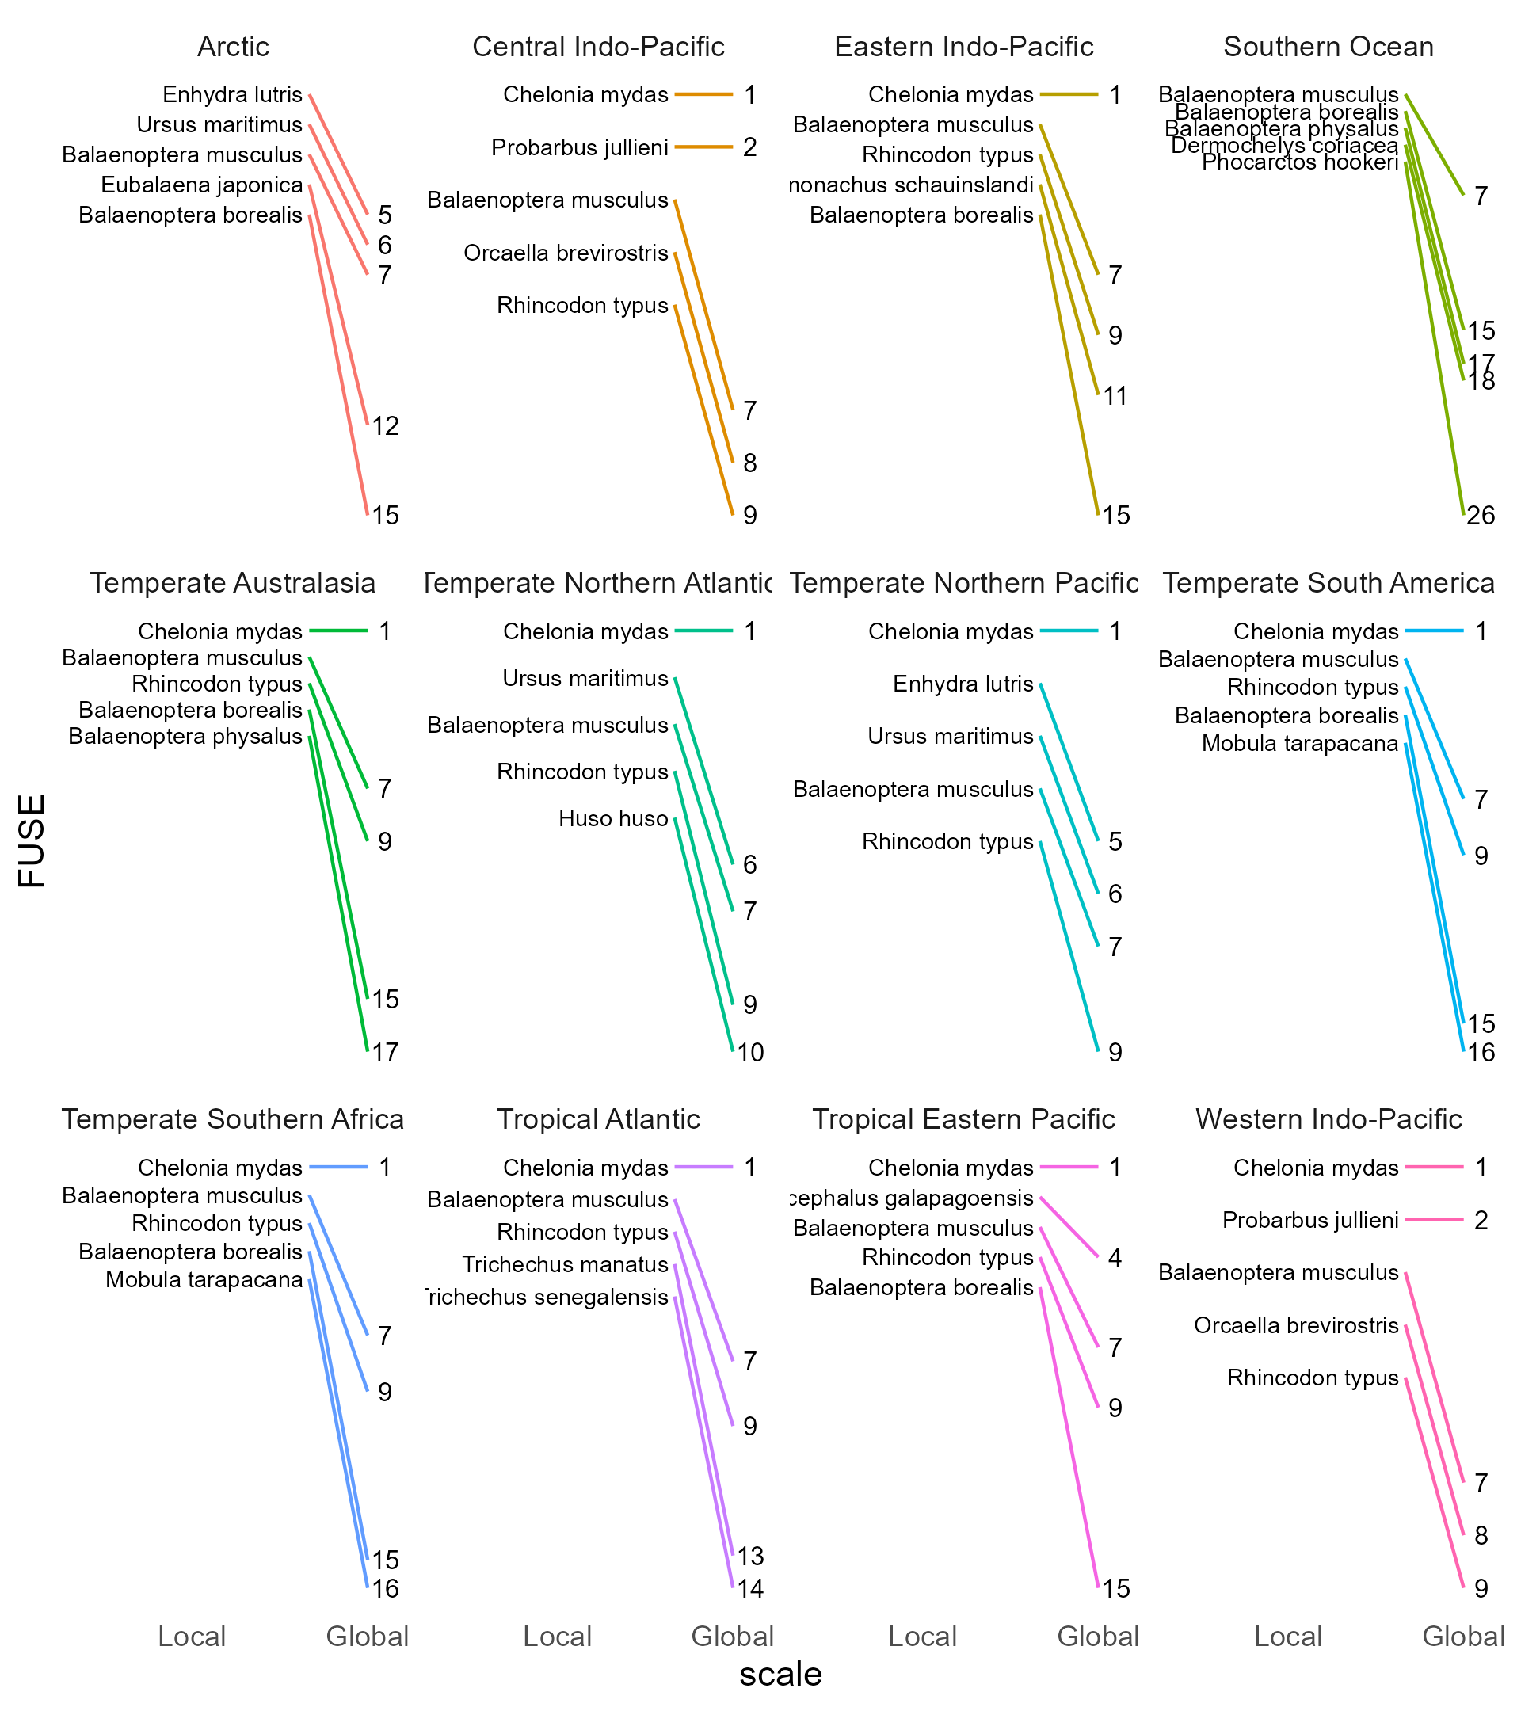

Slide 4
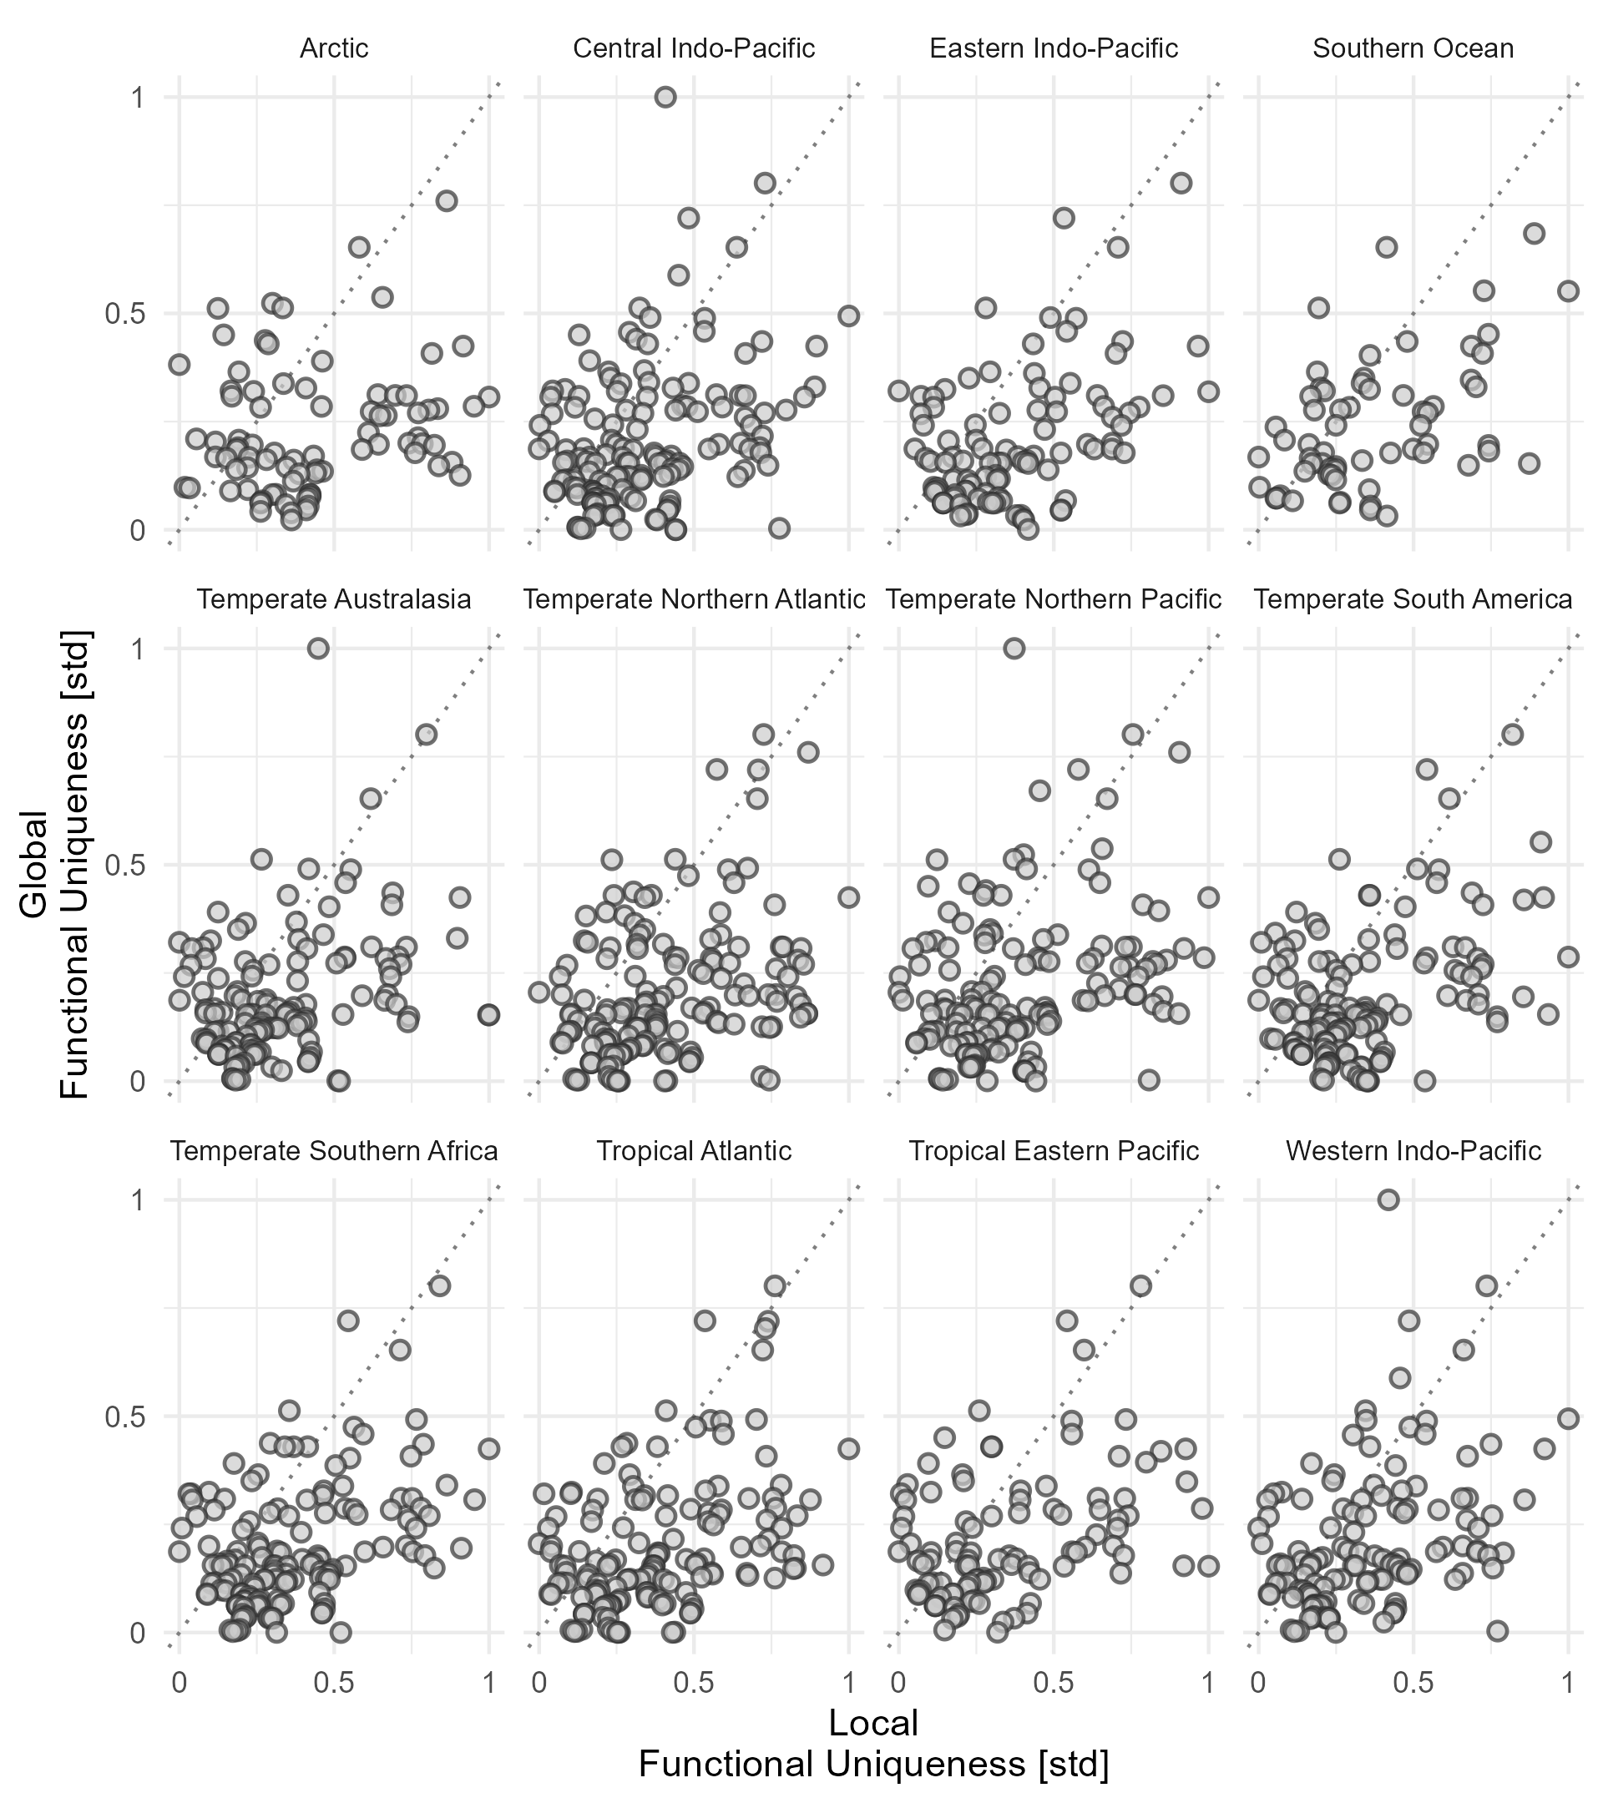

Slide 5
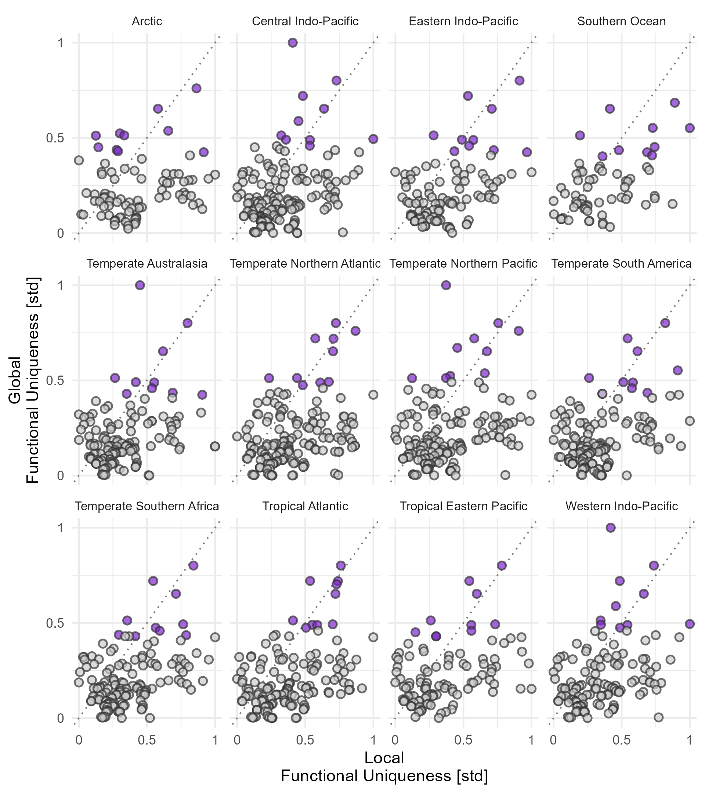

Slide 6
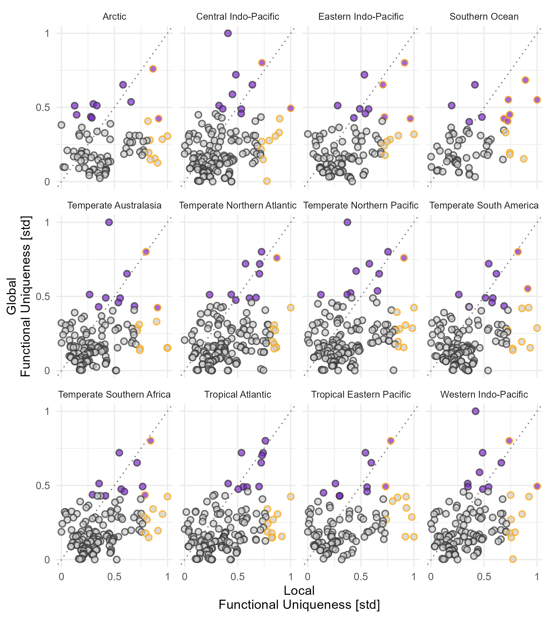

Slide 7
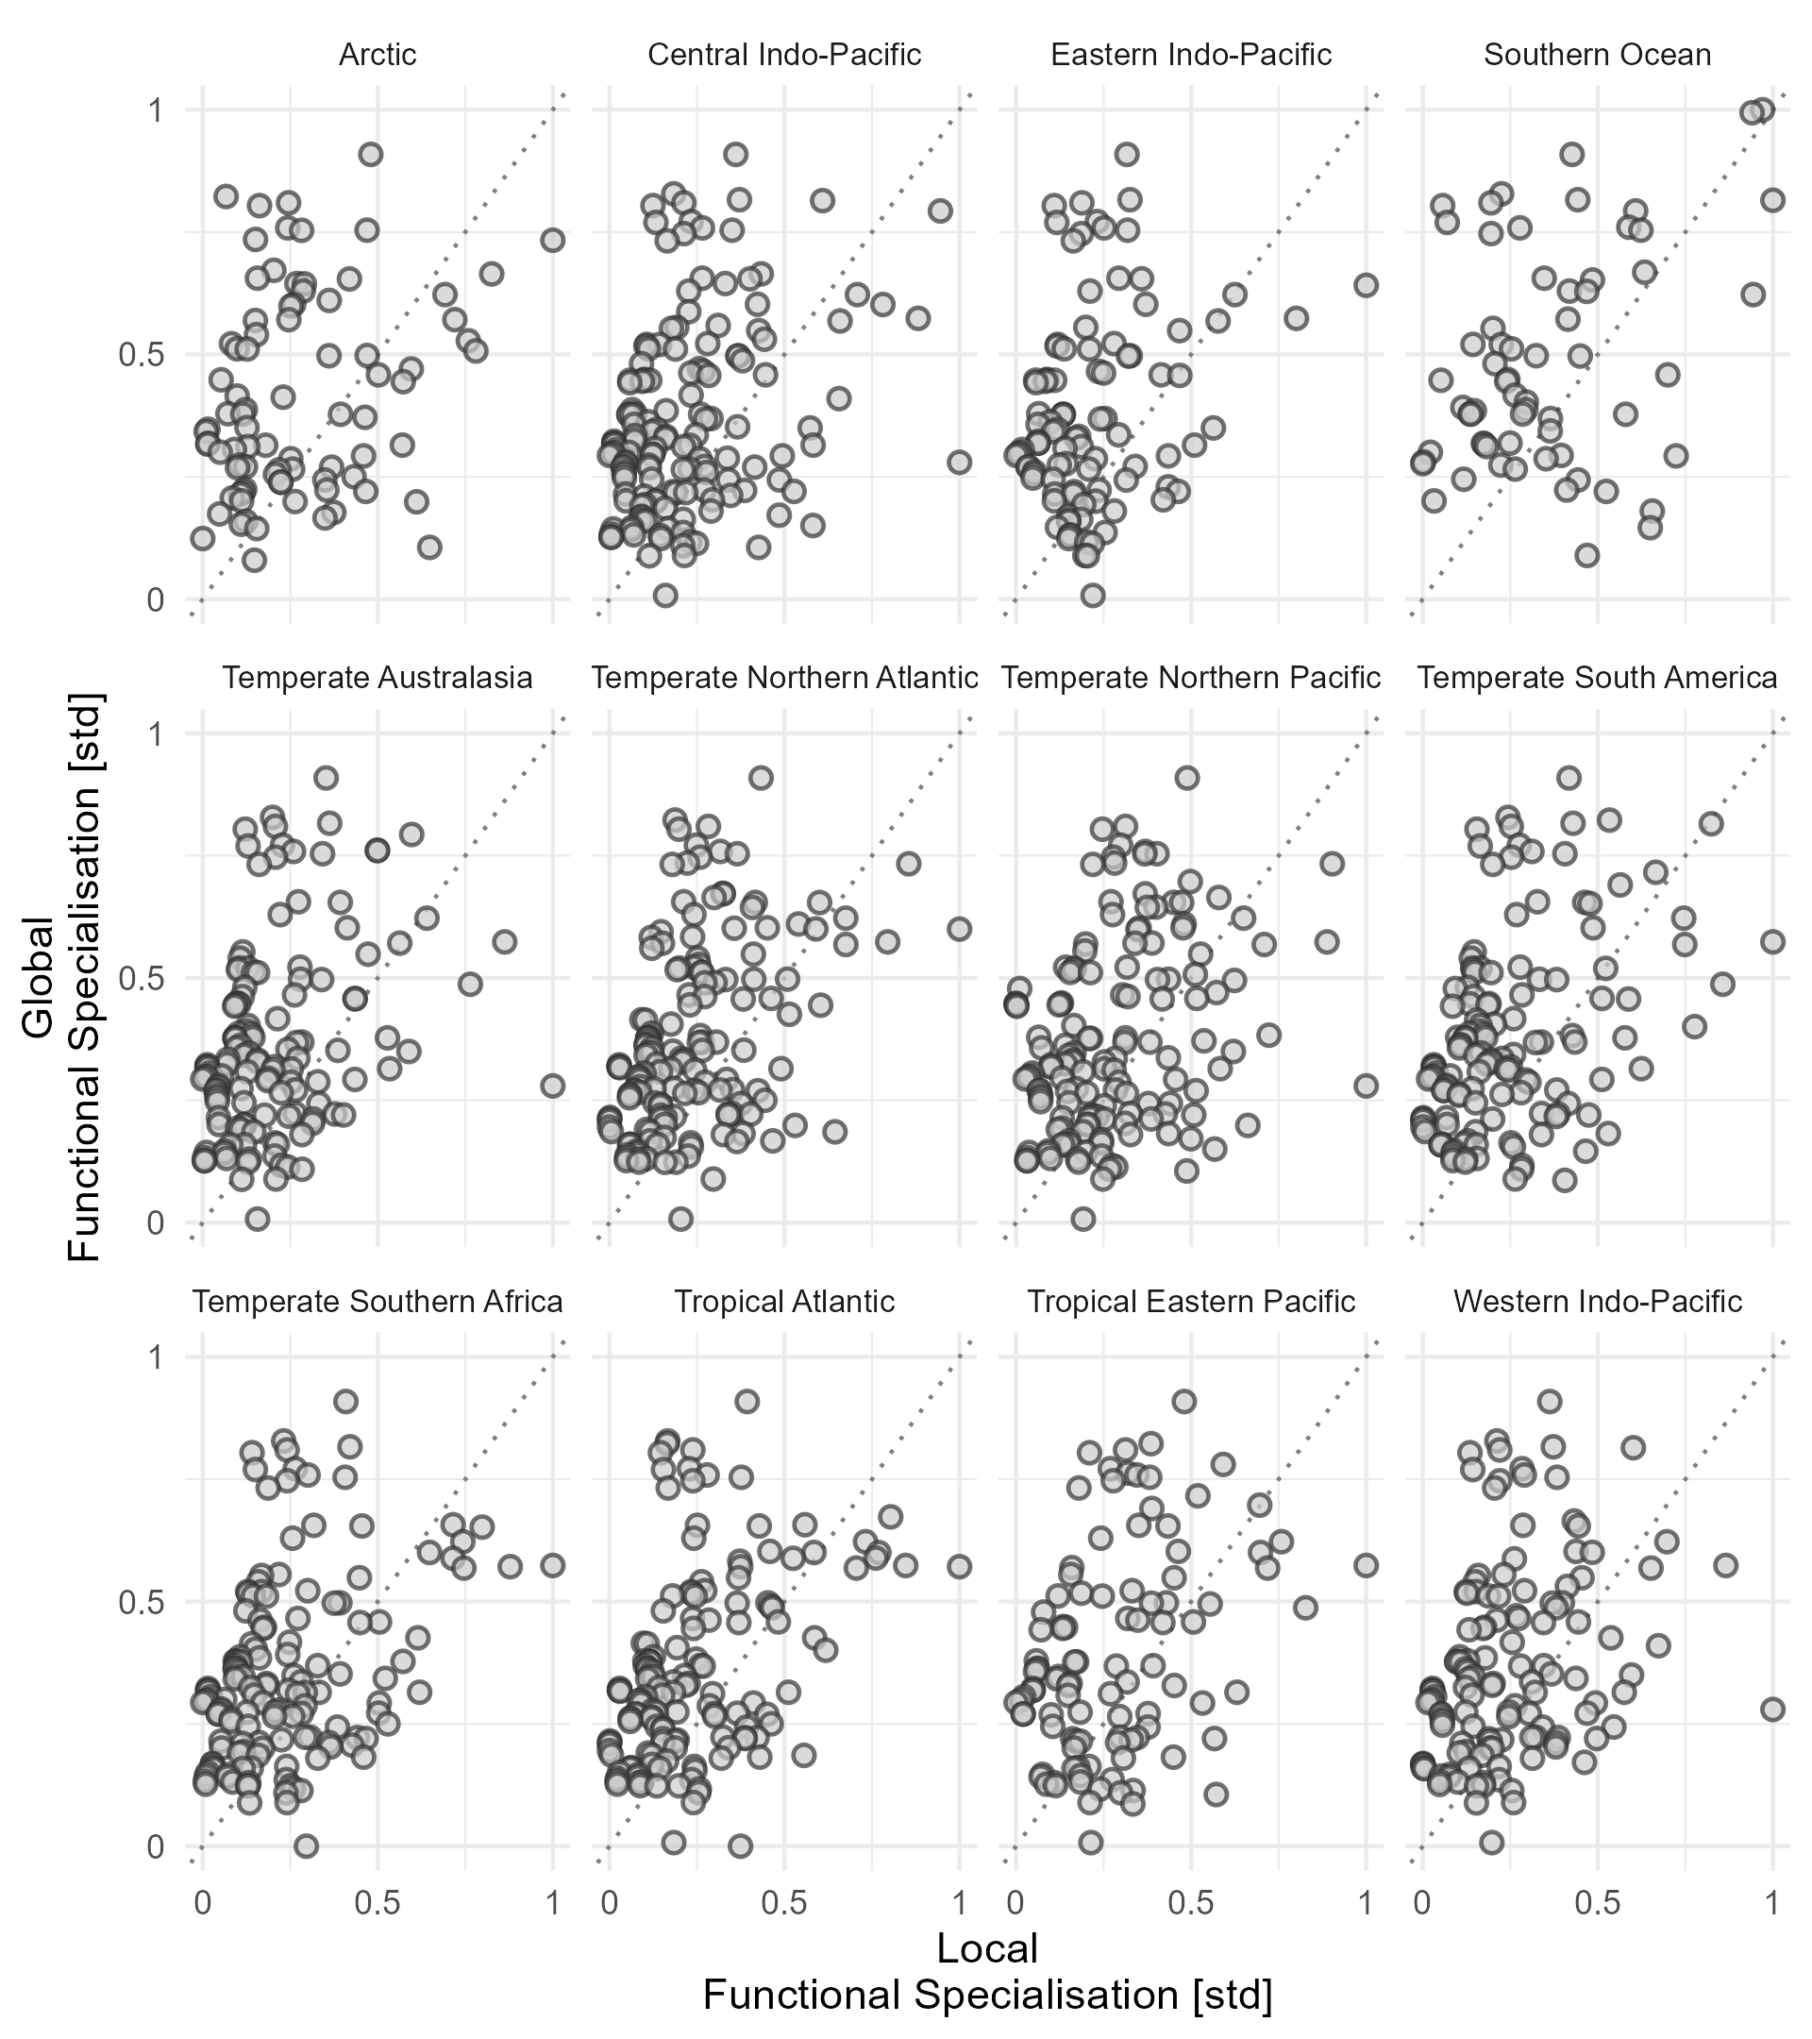

Slide 8
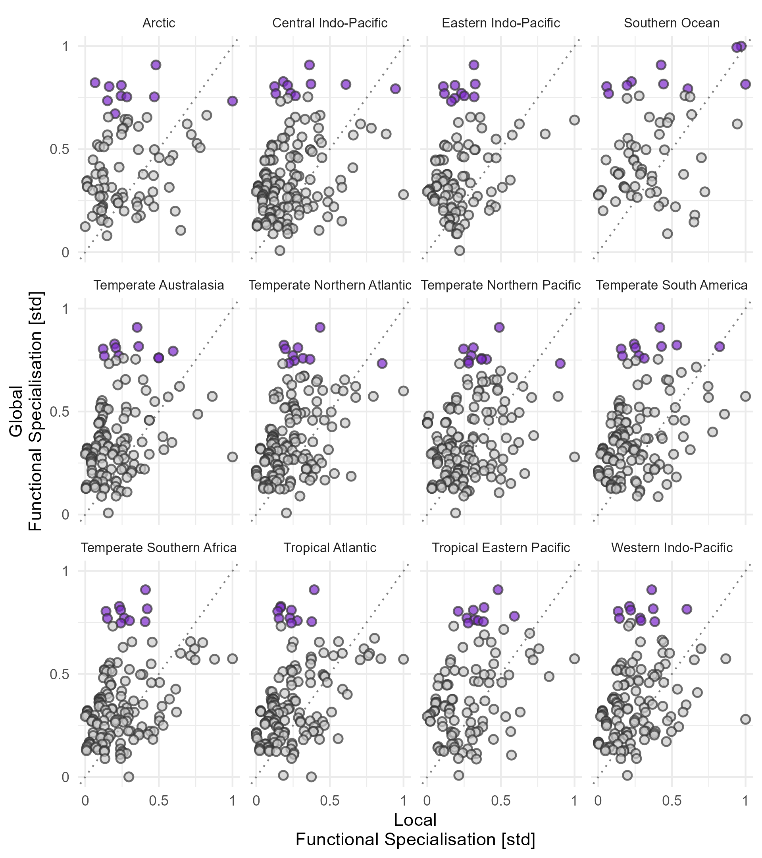

Slide 9
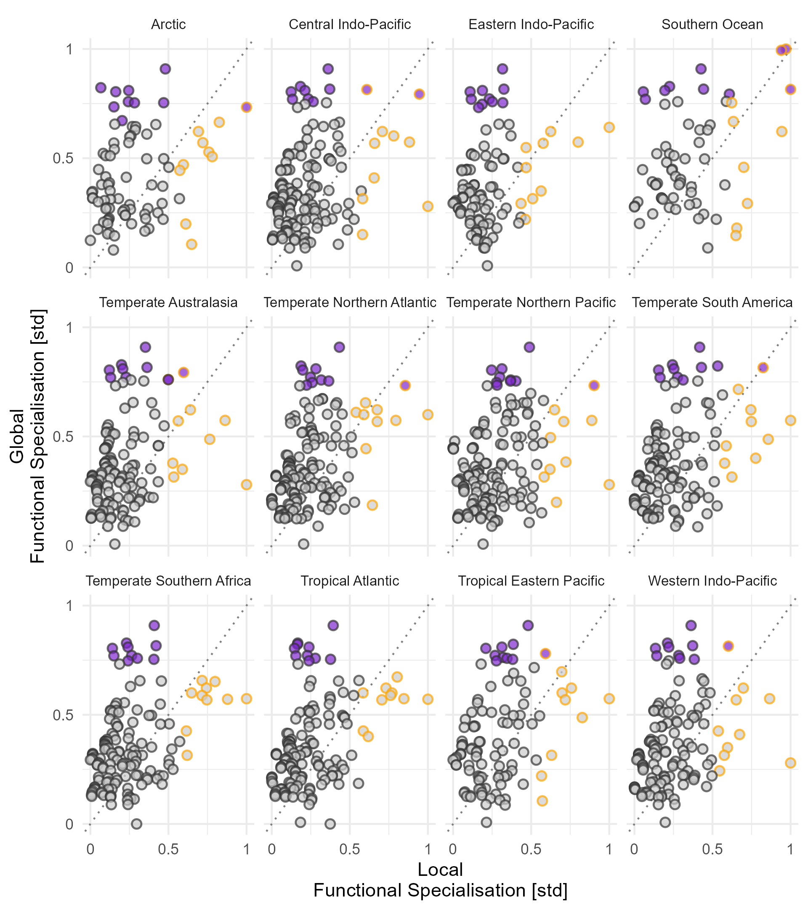

Slide 10
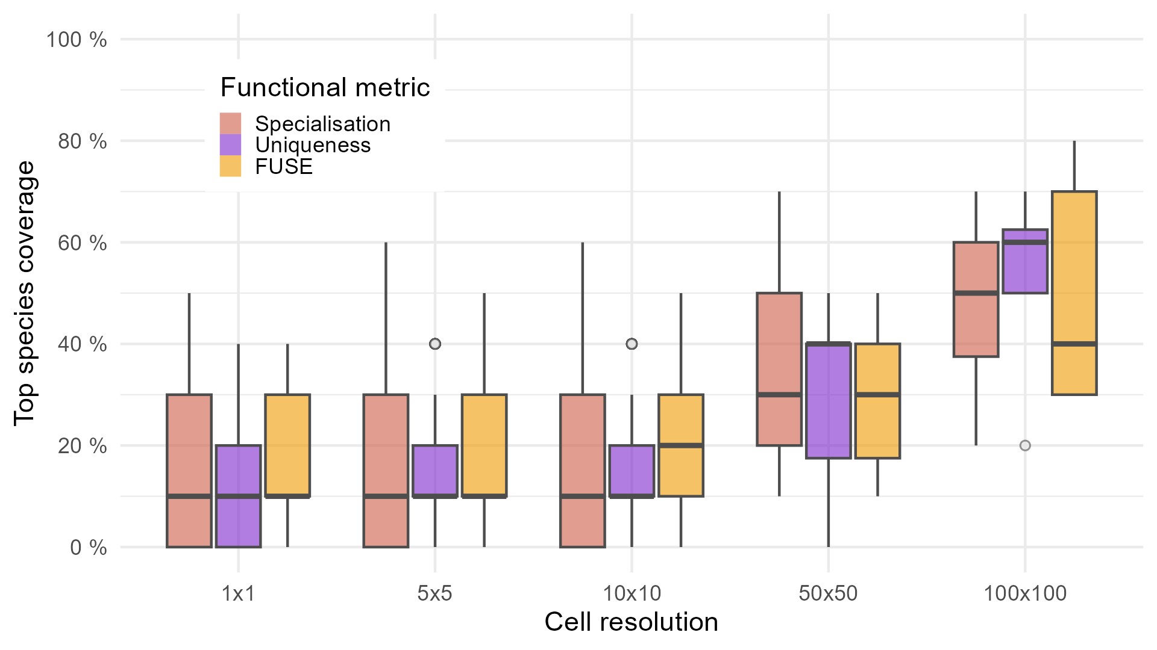

Slide 11
Region a
a
Global FD
b
EN
EN
EN
High FUSE
Region b
+ Uniqueness
+ Specialisation
+ Scaling
EN
c
Global list
Region a
Region b
1.
2.
3.
…
12. Species X
13. Species Y
1. Species X
2.
3.
…
1. Species Y
2.
3.
…

Slide 12
Why are globally very important species less important locally?
Some kind of map

